Slide 1
THERMOKOL.INDIA

Slide 2
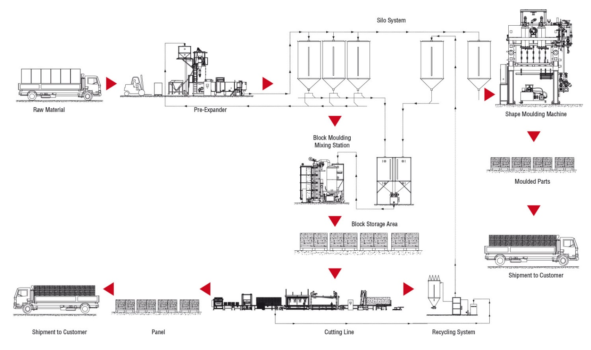
THERMOCOL MANUFACTURING PROCESS

Slide 3
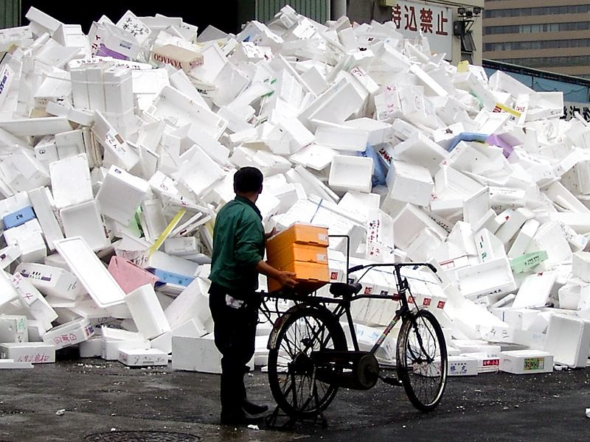
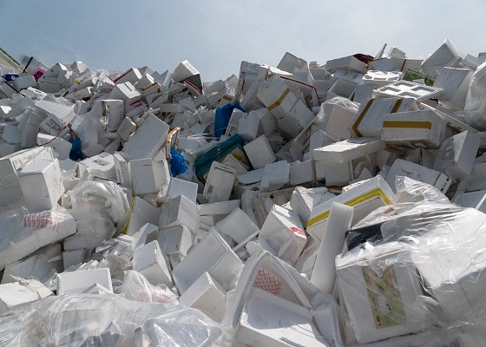
WASTE THERMOCOL
WE HAVE A SOLUTION
THERMOKOL.INDIA

Slide 4
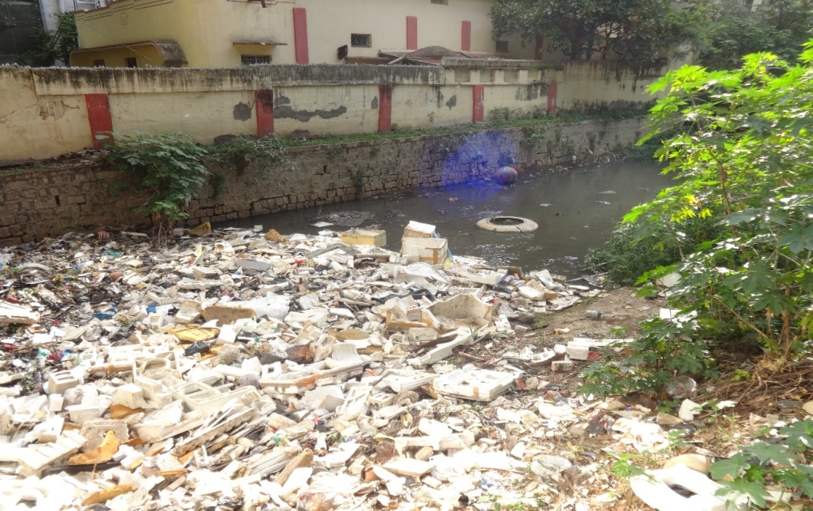
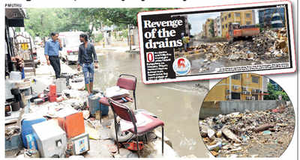
WATER (DRAINS) POLLUTION DUE TO THERMOCOL
WE HAVE A SOLUTION
THERMOKOL.INDIA

Slide 5
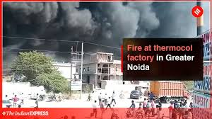
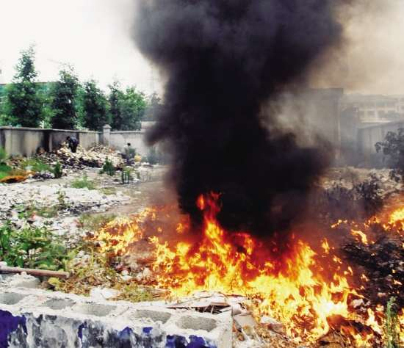
AIR POLLUTION (FIRE) DUE TO THERMOCOL
WE HAVE A SOLUTION
THERMOKOL.INDIA

Slide 6
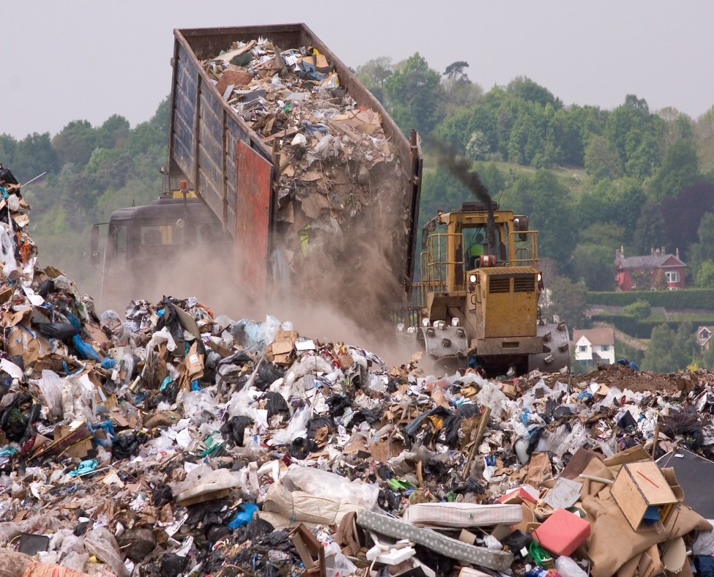
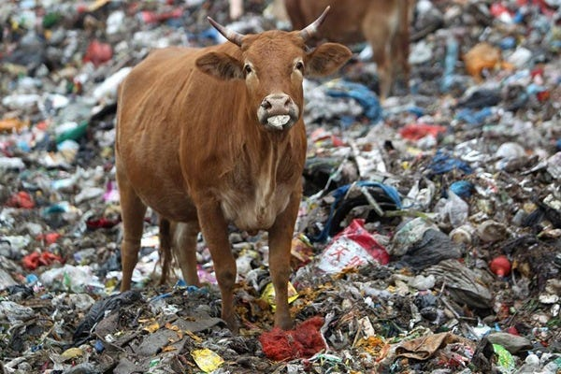
LAND POLLUTION (DUMPING YARDS) DUE TO THERMOCOL
WE HAVE A SOLUTION
THERMOKOL.INDIA

Slide 7
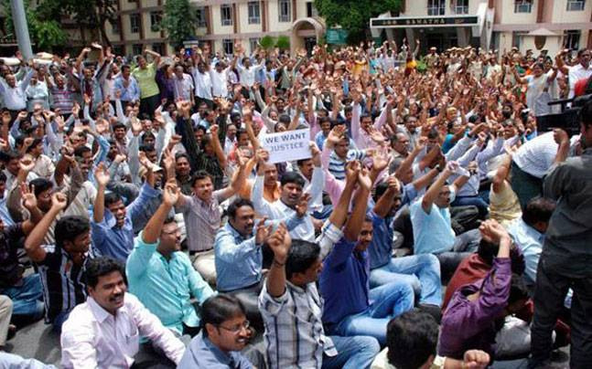
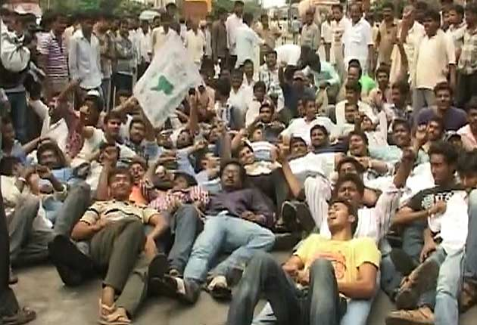
UN EMPLOYED
POPULATION
WE HAVE A SOLUTION
THERMOKOL.INDIA

Slide 8
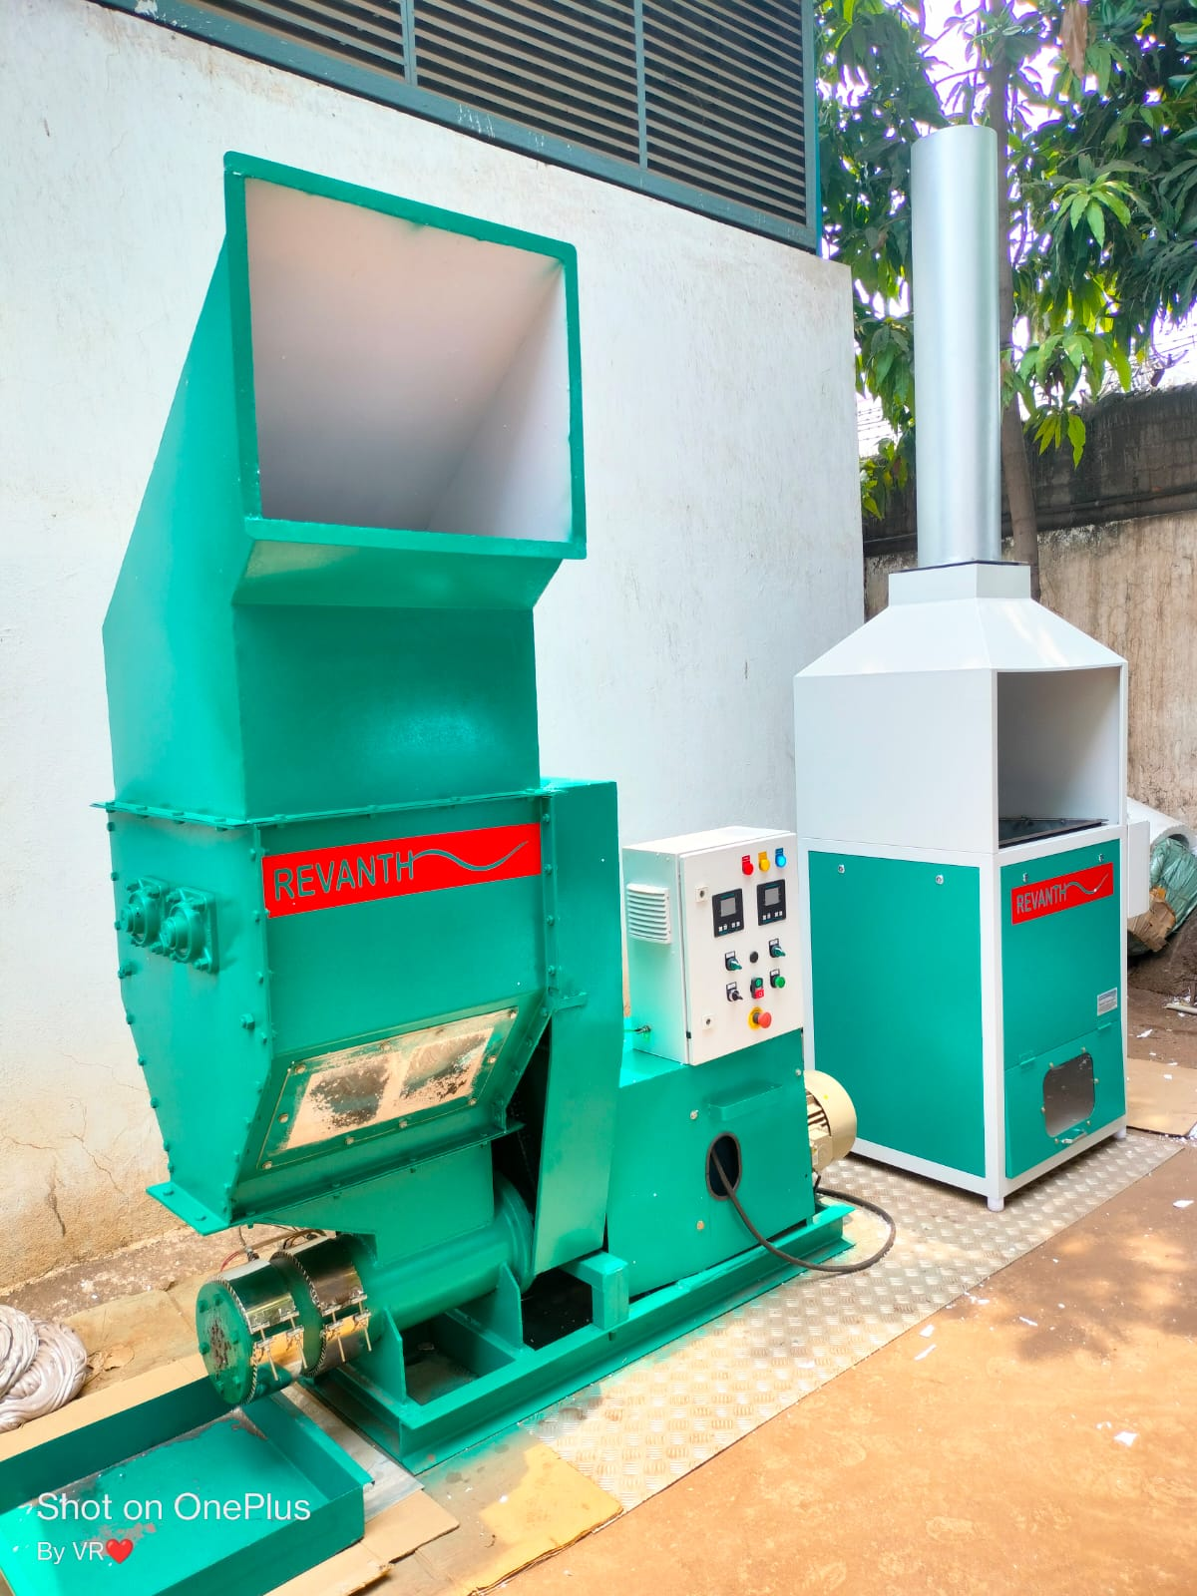
WE HAVE A SOLUTION FOR THE WASTE THERMOCOL RECYCLING

Slide 9
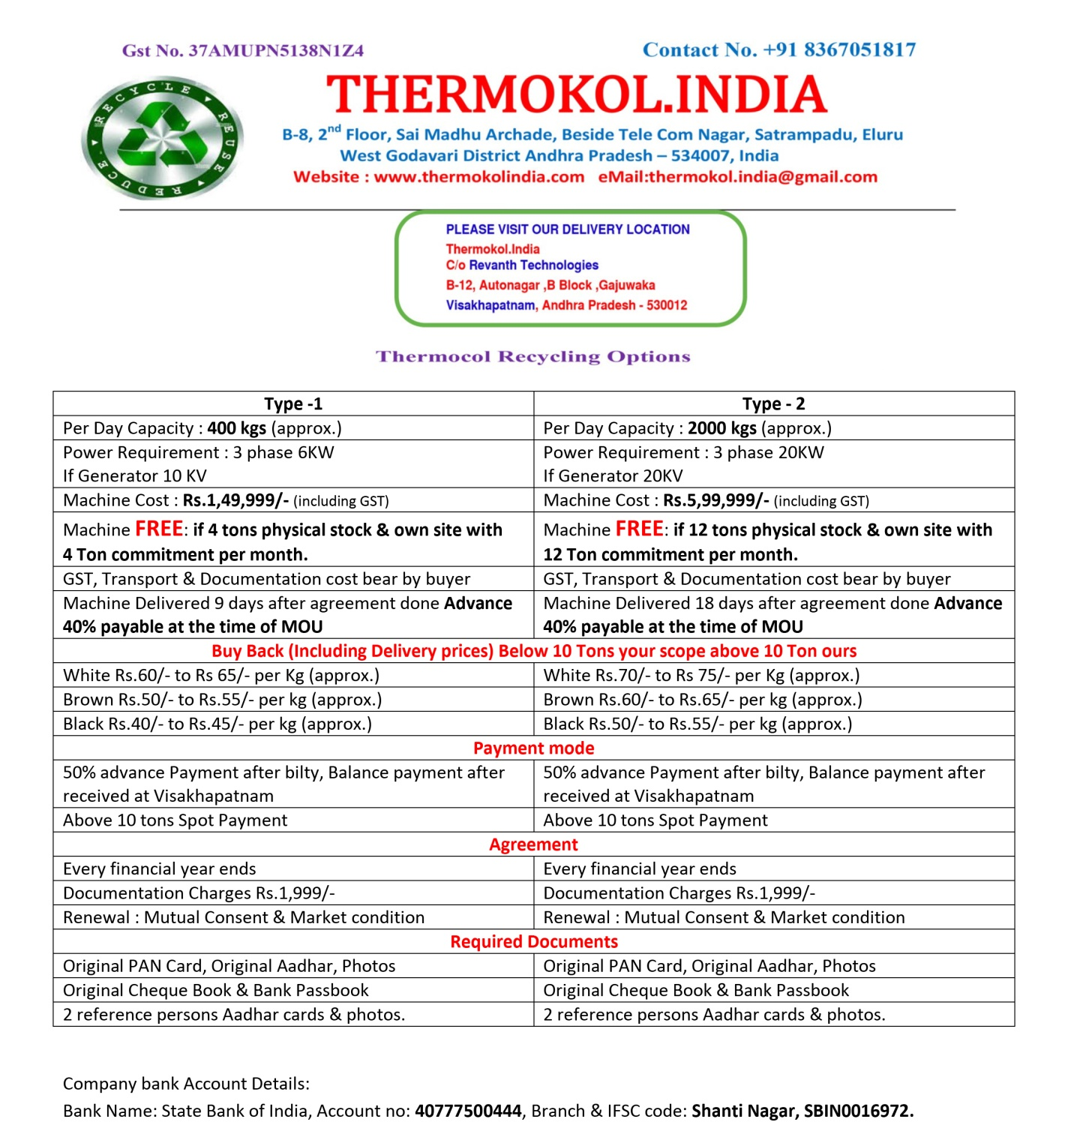
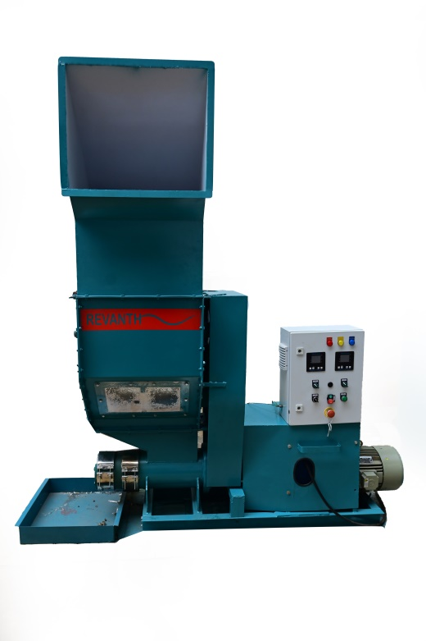
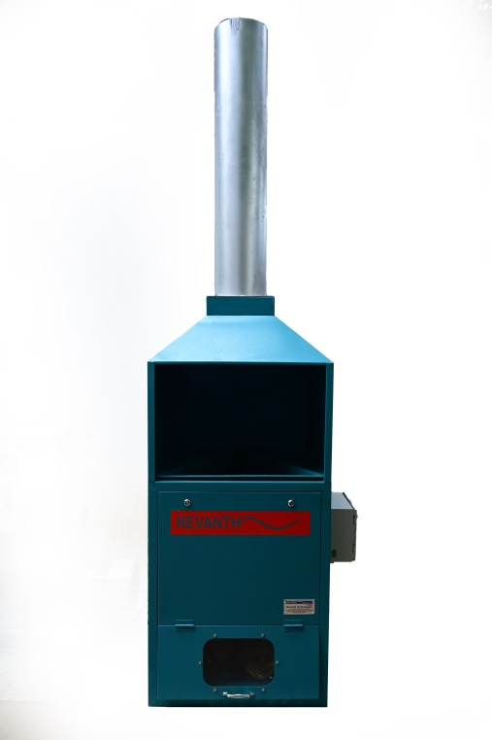
TYPE 2
Price: 5,99,999/-
(Including GST)
TYPE 1
Price: 1,49,999/-
(Including GST)

Slide 10
THERMOKOL.INDIA
VISIT TO VISAKHAPATNAM
TRAINING & MOU
INSTALLATION & TRAILS
DISPATCH THROUGH
MACHINERY ADVANCE
VIDEO CONFIRMATION BEFORE PACKING
DISPATCH THROUGH
EPS MELTING
QC CONFIRMATION TO ACCOUNTS DEPARTMENT
QC INSPECTION
AT VISAKHAPATNAM
BILLING & BILTY
( 50% )
PROCESS FLOW CHART
RELEASE ONLINE PAYMENT
(BALANCE 50% )
MATERIAL STORAGE AT WARE HOUSE

Slide 11
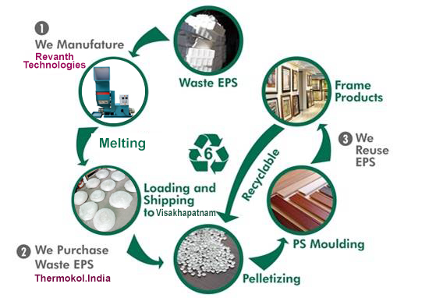

Slide 12
SALES, SERVICE & SUPPORT
7386301817 - Sales
7396301817 – Sales
9755541817 - Service
9989231817 – Purchase
9550161817 – Dispatch & Testing
8367051817
thermokol.india@gmail.com
www.thermokolindia.com
thermokol.india
thermokol.india
thermokol.india
thermokol.india

Slide 13
THANK YOU

